Slide 1
Open Dataset and Decentralized Compute for LLMs
Tri Dao Together AI / Princeton University
https://tridao.me
Notes:
Hi everyone, I’m Tri and I’m excited to be here to talk about my research on hardware-aware algorithms for efficient ML.
This is at the interaction of ML and systems, and we’ve seen a lot of promising results especially recently that I’d love to share with you.

Slide 2
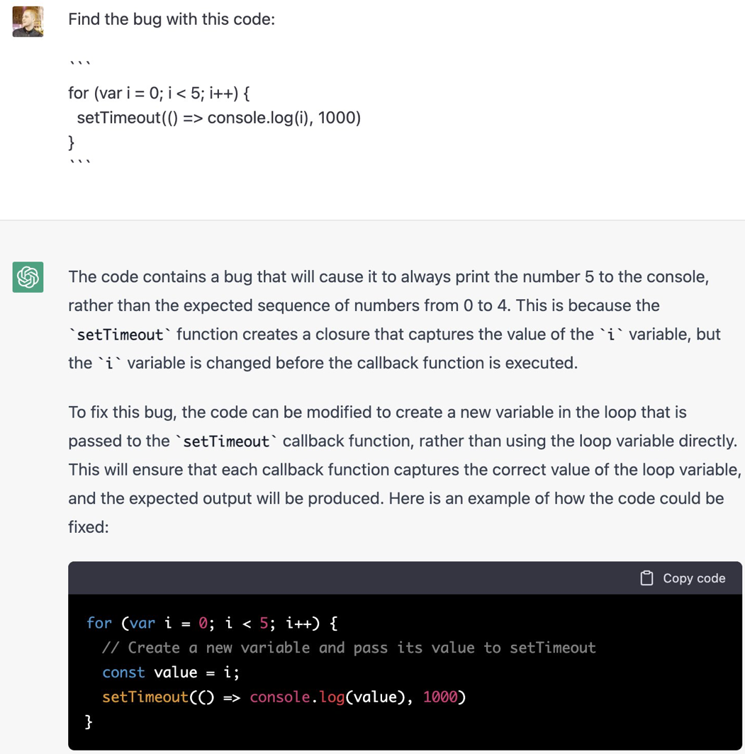
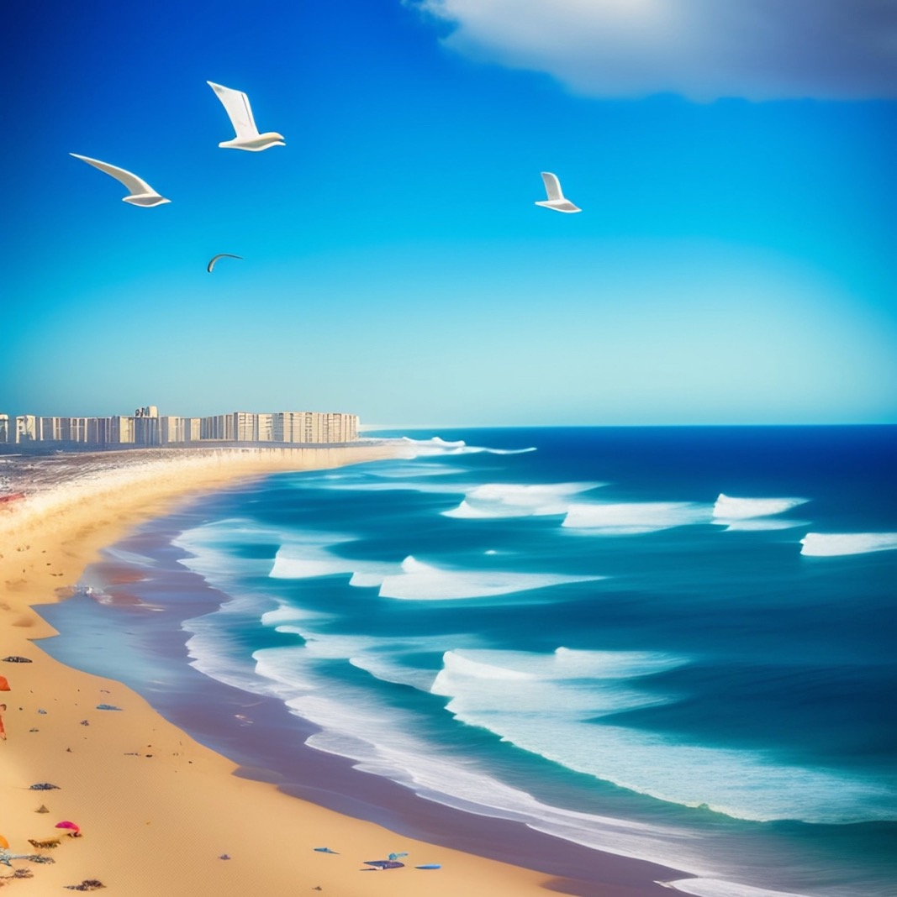
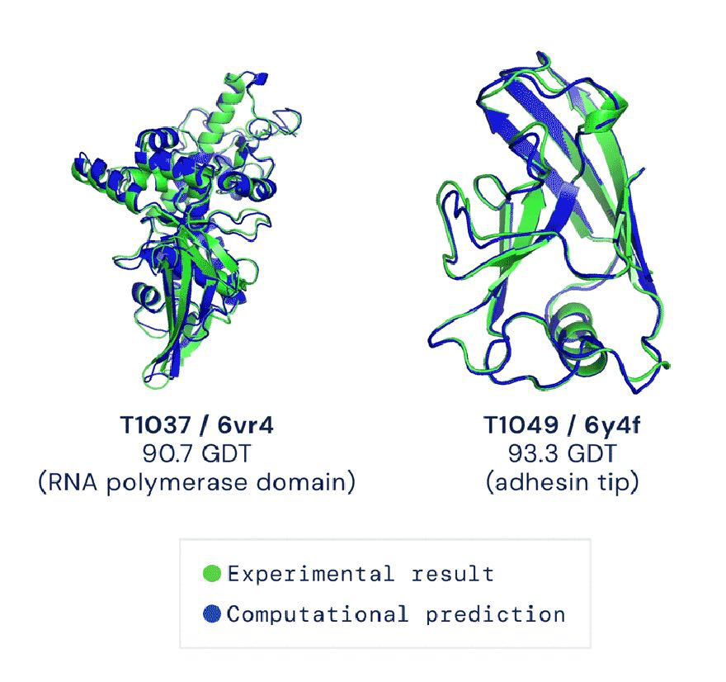
Machine Learning Has Made Exciting Progress
Fix Bugs (ChatGPT/GPT4 - OpenAI)
Generate Art (Stable Diffusion – Stability.AI)
Design Drugs (AlphaFold – DeepMind)
What enabled these advances? What are outstanding problems? How do we approach them?​
Notes:
To motivate my research interests, I'll mention some exciting progress in ML.
Nowadays we have amazing ML models that can do things we didn’t even think was possible even a few years ago.
1. You can go on ChatGPT right now and paste a snippet of code, and it would help you find the bug, fix it, and explain it to you
2. You can generate impressive fun pictures by just prompting the model with what you want in the picture. Here I’m showing an illustration of NYC. As you can see, it does a pretty impressive job, in just a few seconds.
3. We can now predict protein and RNA structures really well, and a bunch of companies including DeepMind are using these models to design new drug.
We’ll try to understand what enabled these advances, what are some of the outstanding problems, and how to tackle them.
[Neel]: should add these as a separate slide
Karan:
1. There's a lot of jargons from different areas.
2. Underselling why some results are interesting and impressive. Disambiguate this is more than just a general "efficient ML" talk.
Slides need more formatting, more polished. [Aligning things, fonts are consistent]
Timescales are only within last 5 years. Why is this important to solve problems in the long term (5-10 years).
Need explanation: efficiency is important because it has impact on these things: faster is great, low-memory enables
Dan:
Title: didn't differentiate compared to an "efficient ML" talk. Maybe put "hardware-aware"?
Motivation: unclear and changed a lot. Maybe have an outline?
Slides: different visual language (fonts).
Sparsity section: need to be unpacked. Not clear what the challenges were.
Maybe swap Monarch and FA?
Title of this slide might invite more attacks.
Khaled:
Motivation on long sequences were weak. Replace the ice cream example.
More takeaway in the slides. More bold and red.
Karan: don't focus on beating nvidia too much. They've been thinking about this for a long time, and thinking about things from 1st principle can actually improve.
Future work: more about "thinking about fundamentals"
[Neel]: Intro is too long (10 pages), try to get down to 5 slides.

Slide 3
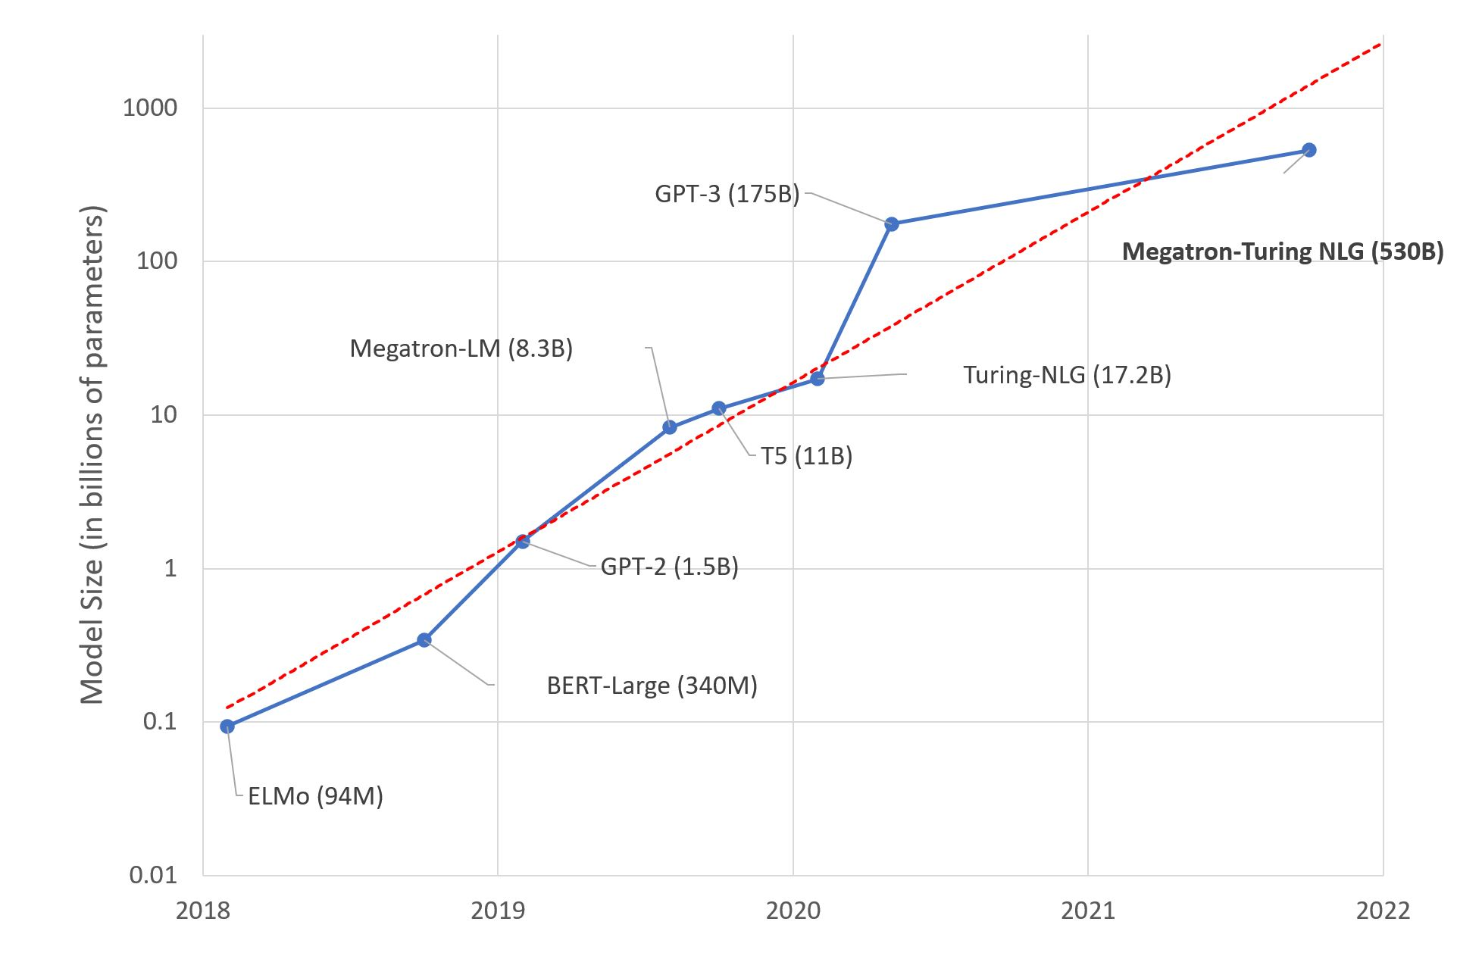
Scale in Data and Compute Brings Quality and Capabilities
Language models explaining jokes
500 billion
2022
Input: I tried 10000 random restarts of my neural network, but I was accused of overfitting. I guess no good seed goes unpunished.
1.3B model: The joke is that if you try 10000 different seed choices, you'll eventually find one that works, but you'll be accused of overfitting.
175B model: This joke is a play on words related to neural networks, a type of machine learning algorithm.
The punchline, "I guess no good seed goes unpunished," is a play on the phrase "no good deed goes unpunished." In this case, "good seed" refers to a starting point for the random restarts, and the joke implies that even when trying to improve the neural network's performance, the person is still accused of overfitting.
100 million
2018
c
Scale is more closely tied to advances in ML than ever before
Notes:
One popular narrative is that data and model scale has improved model quality and given these models new capabilities.
In just a couple of years, model sizes have increased a thousand fold, for example from BERT large with 340M to Megatron and Palm with 500B.
Not only do larger models get higher quality, they also get new capabilities. Here are some results showing that in many cases, as models get larger, there’s a phase transition where they get new capabilities, such as transliteration of word unscrambling or writing poetry.

Slide 4
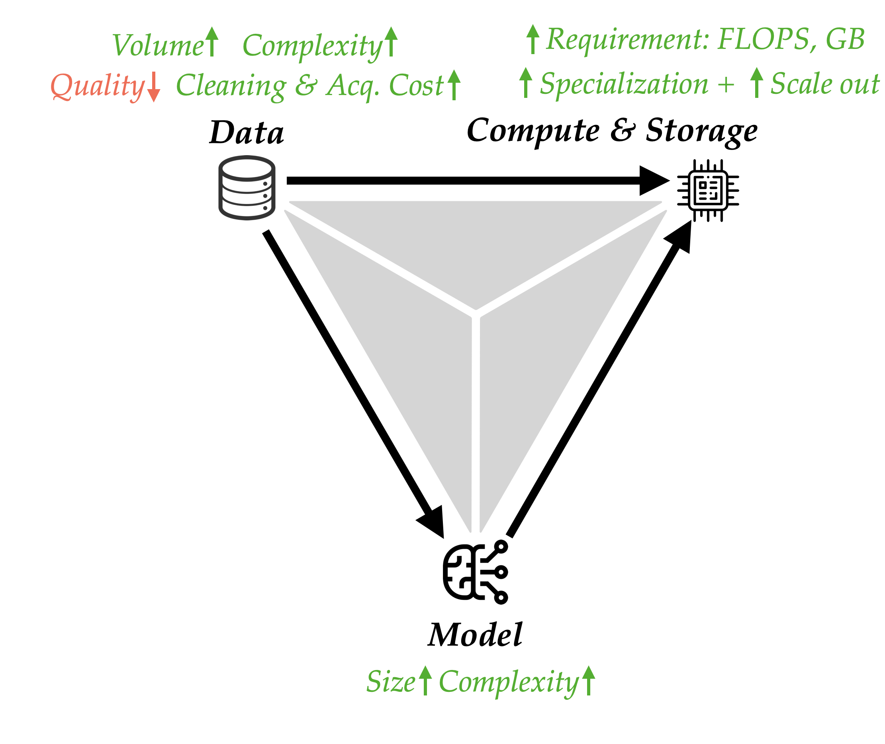
Challenges with Scale

Slide 5
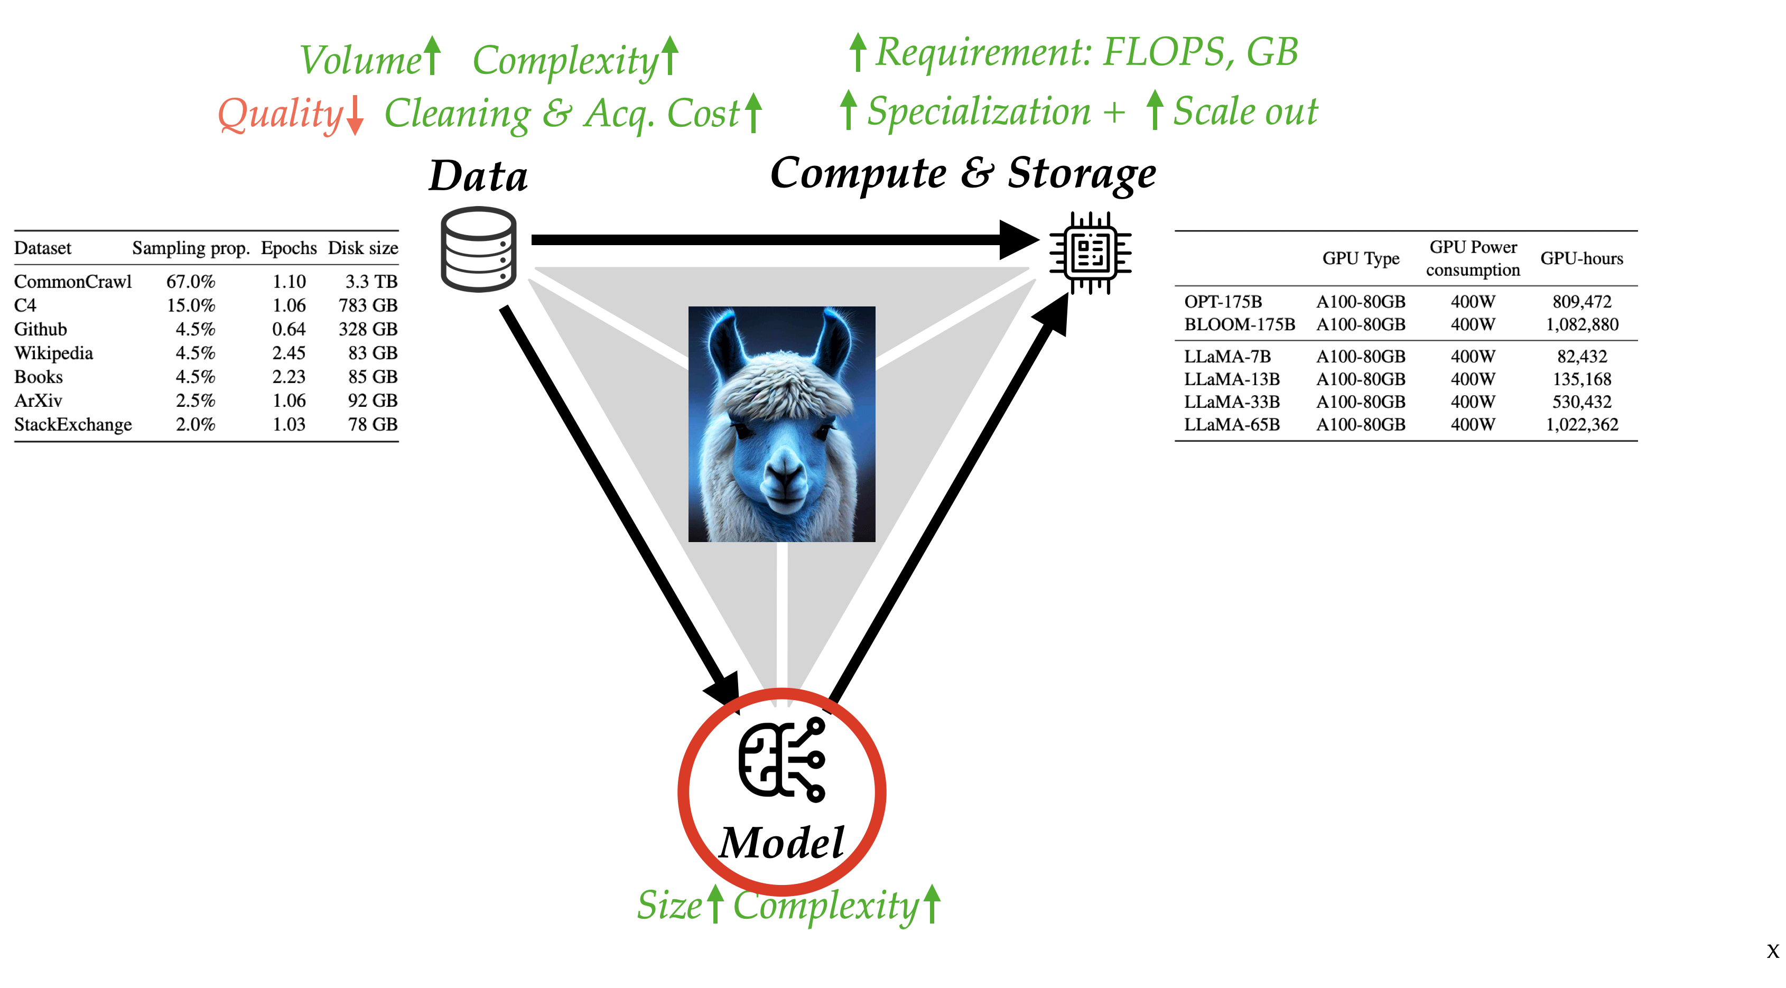
The Llama Moment

Slide 6
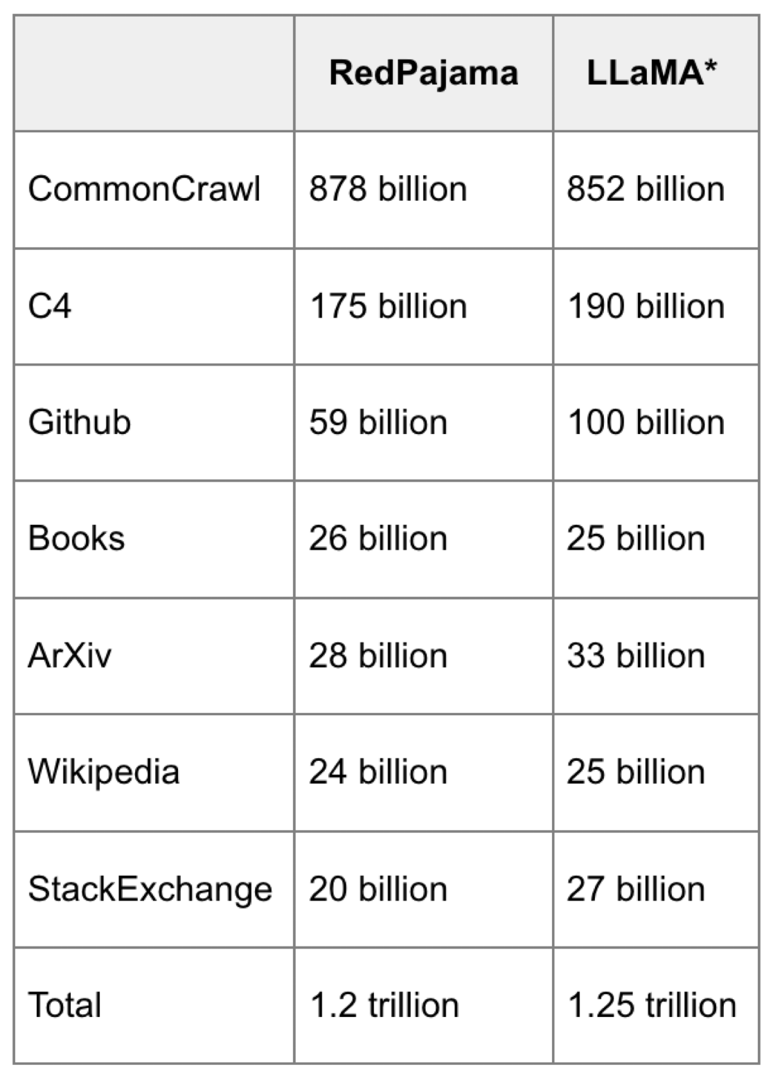
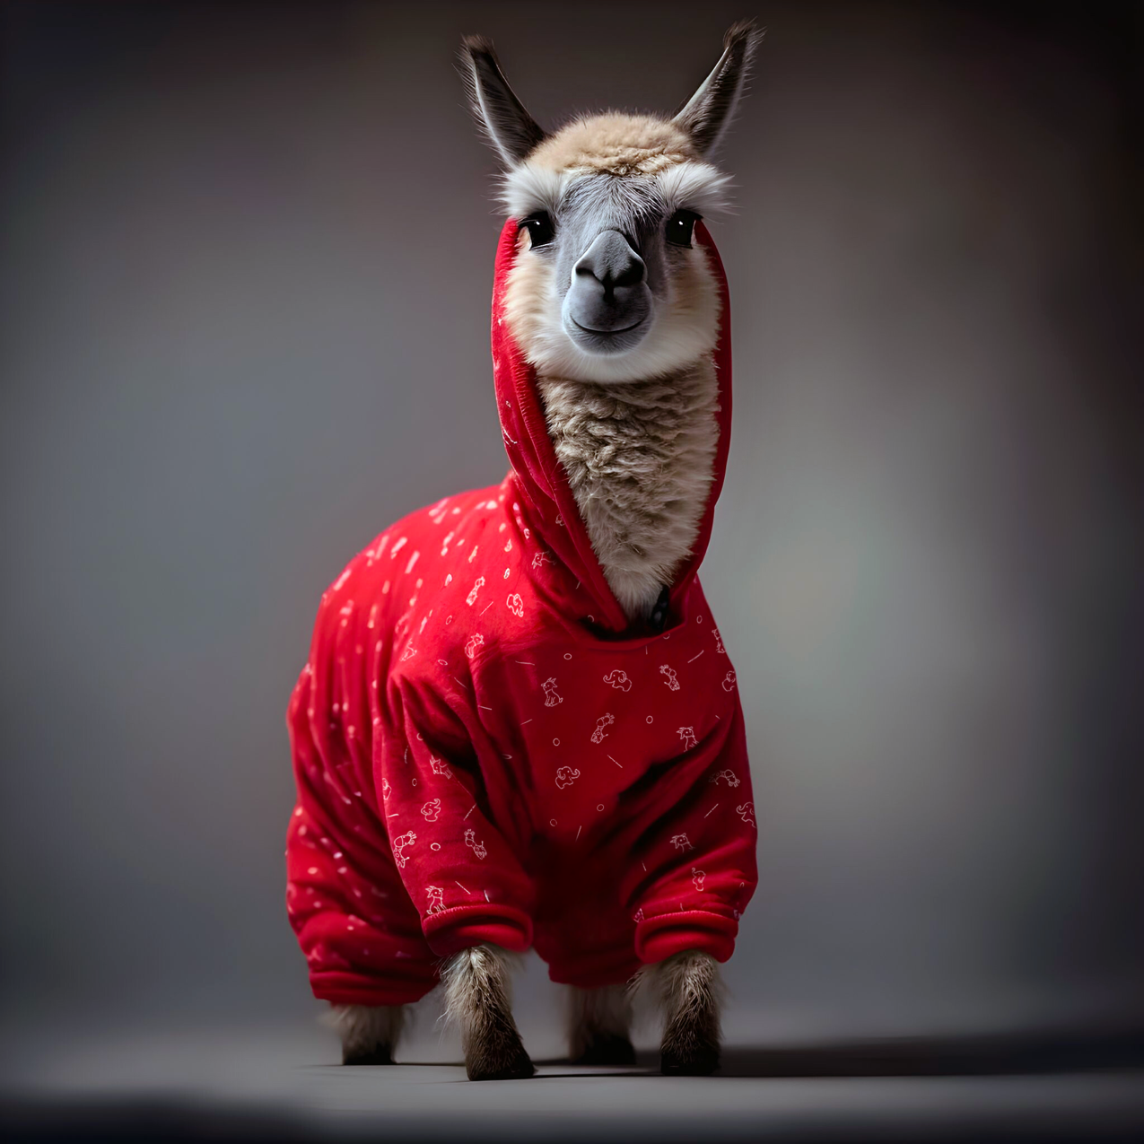
RedPajama v1: Data
CommonCrawl
C4
GitHub
arXiv
Books
Wikipedia
StackExchange

Slide 7
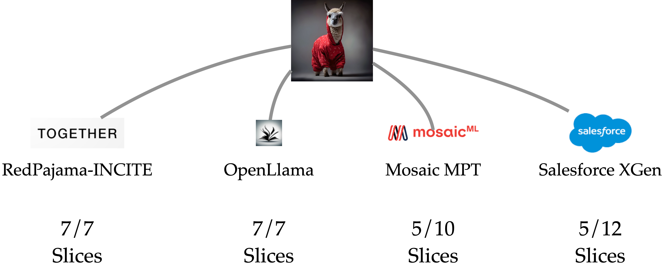
Fueling and Exciting Generation of Open Models
Notes:
My insight to tackle the efficiency and quality problem is that we need to understand both the algorithms and the the hardware.
As an example, all ML is matmul and nonlinearility. And computational bottleneck is dense matmul. By looking at what’s fast and slow on GPUs and other accelerators, we can leverage block-sparsity that yields some of the first sparse methods with wall-clock speedup. I’ll talk about Monarch matrices, which is part of a long-line of work on learnable fast transforms.
For another application, attention, the heart of the transformer architecture, is fundamental to all these impressive capabilities. With FlashAttention, by using classical techniques such as tiling, we can reduce GPU memory reads/writes and bring significant speedup.
[Dan] Maybe this "thesis statement" can come early.
[Karan] Could be 1/2 as long, clearly, say more about who you are.
[Dan] Developing hardware-aware algo could help ML:
1. FlashAttention
2. Take sparsity ideas that's been around in the community and actually make that work.
[Neel] Lots of jargons.
Maybe too details for the intro
Don't say "i've been playing with"

Slide 8
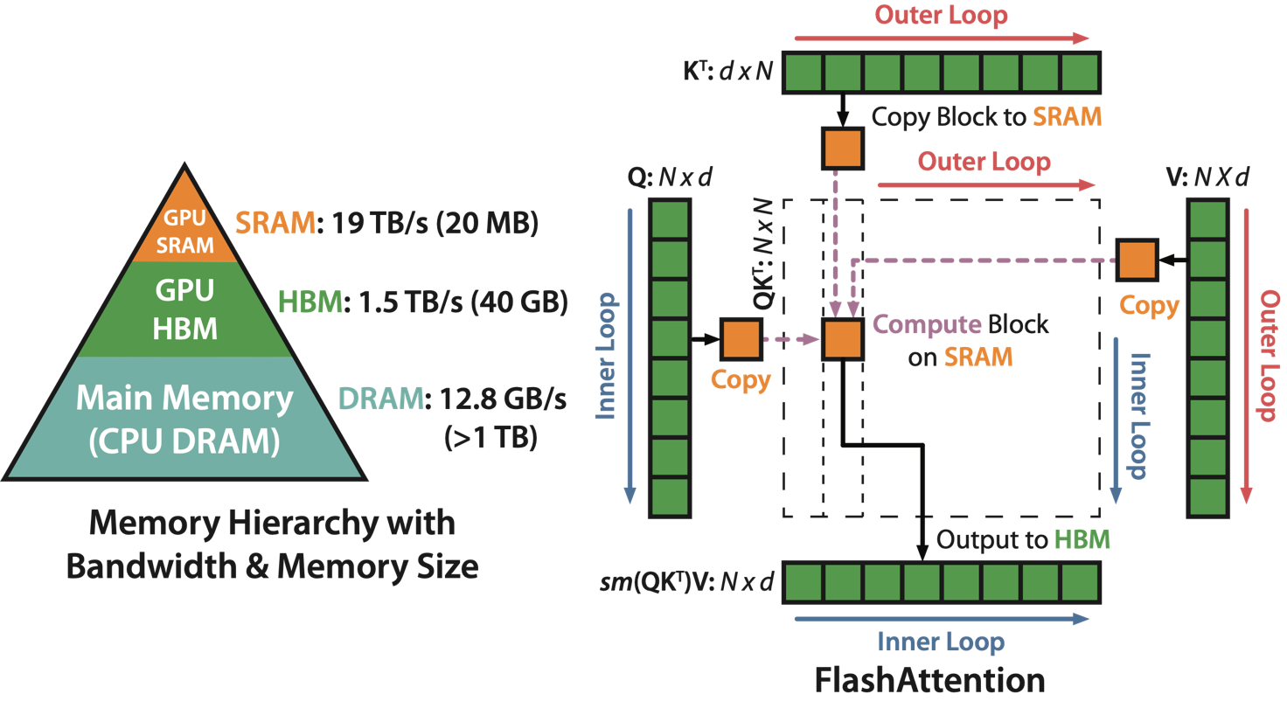
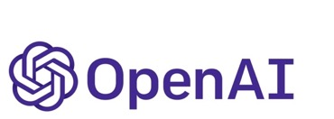


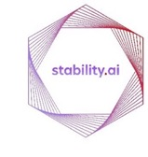







Compute: Hardware-aware Algorithms
IO-awareness: reducing reads/writes to GPU memory yields significant speedup
FlashAttention: fast (2-4x) and memory-efficient attention (10-20x) algorithm, with no approximation
Notes:
My insight to tackle the efficiency and quality problem is that we need to understand both the algorithms and the the hardware.
As an example, all ML is matmul and nonlinearility. And computational bottleneck is dense matmul. By looking at what’s fast and slow on GPUs and other accelerators, we can leverage block-sparsity that yields some of the first sparse methods with wall-clock speedup. I’ll talk about Monarch matrices, which is part of a long-line of work on learnable fast transforms.
For another application, attention, the heart of the transformer architecture, is fundamental to all these impressive capabilities. With FlashAttention, by using classical techniques such as tiling, we can reduce GPU memory reads/writes and bring significant speedup.
[Dan] Maybe this "thesis statement" can come early.
[Karan] Could be 1/2 as long, clearly, say more about who you are.
[Dan] Developing hardware-aware algo could help ML:
1. FlashAttention
2. Take sparsity ideas that's been around in the community and actually make that work.
[Neel] Lots of jargons.
Maybe too details for the intro
Don't say "i've been playing with"

Slide 9

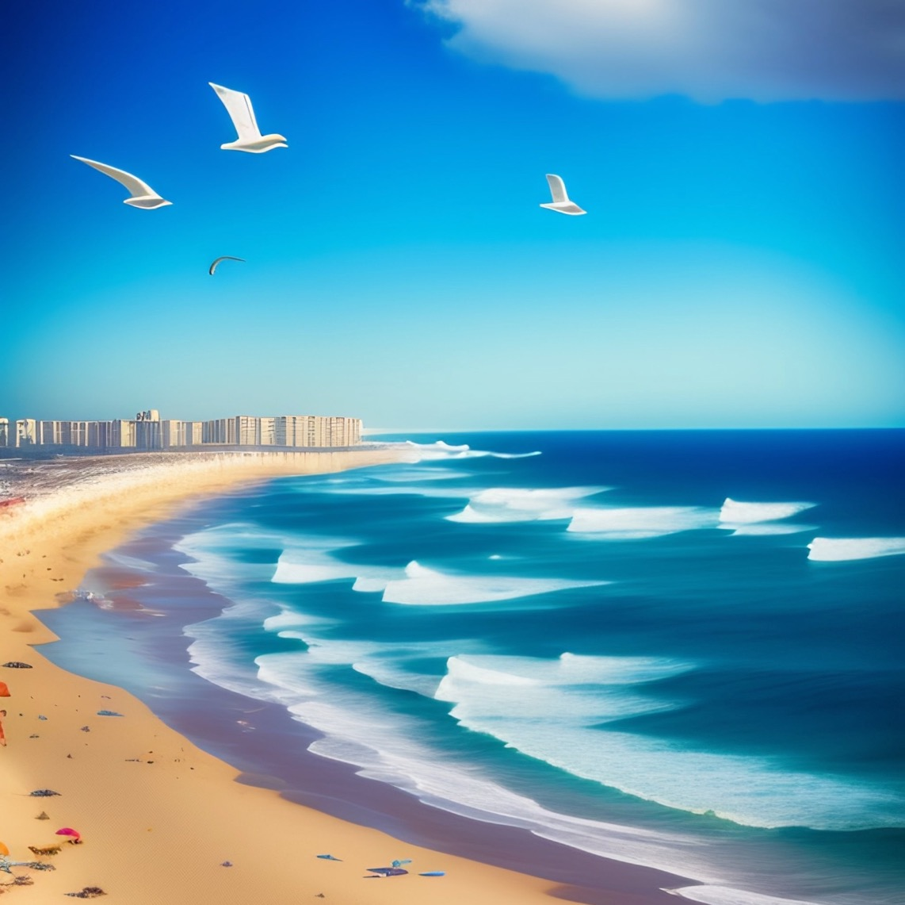
FlashAttention Adoption Areas
Text Generation (Llama – Meta, Falcon – TIIUAE, MPT, RedPajama)
Image Generation (Stable Diffusion - Stability.AI)
Drug Discovery (OpenFold, UniFold)
Notes:
All of the applications I mentioned in the beginning are using FlashAttention.
If you go on ChatGPT right now and play with it, it’s running FlashAttention under the hood.
And if you use huggingface to generate images with Stable Difficution, it’s also running FlashAttention.
DeepMind won’t tell me if they’re using my stuff, but many of opensource alternatives to Alpha Fold 2 are using FlashAttention for fast training and inference.

Slide 10
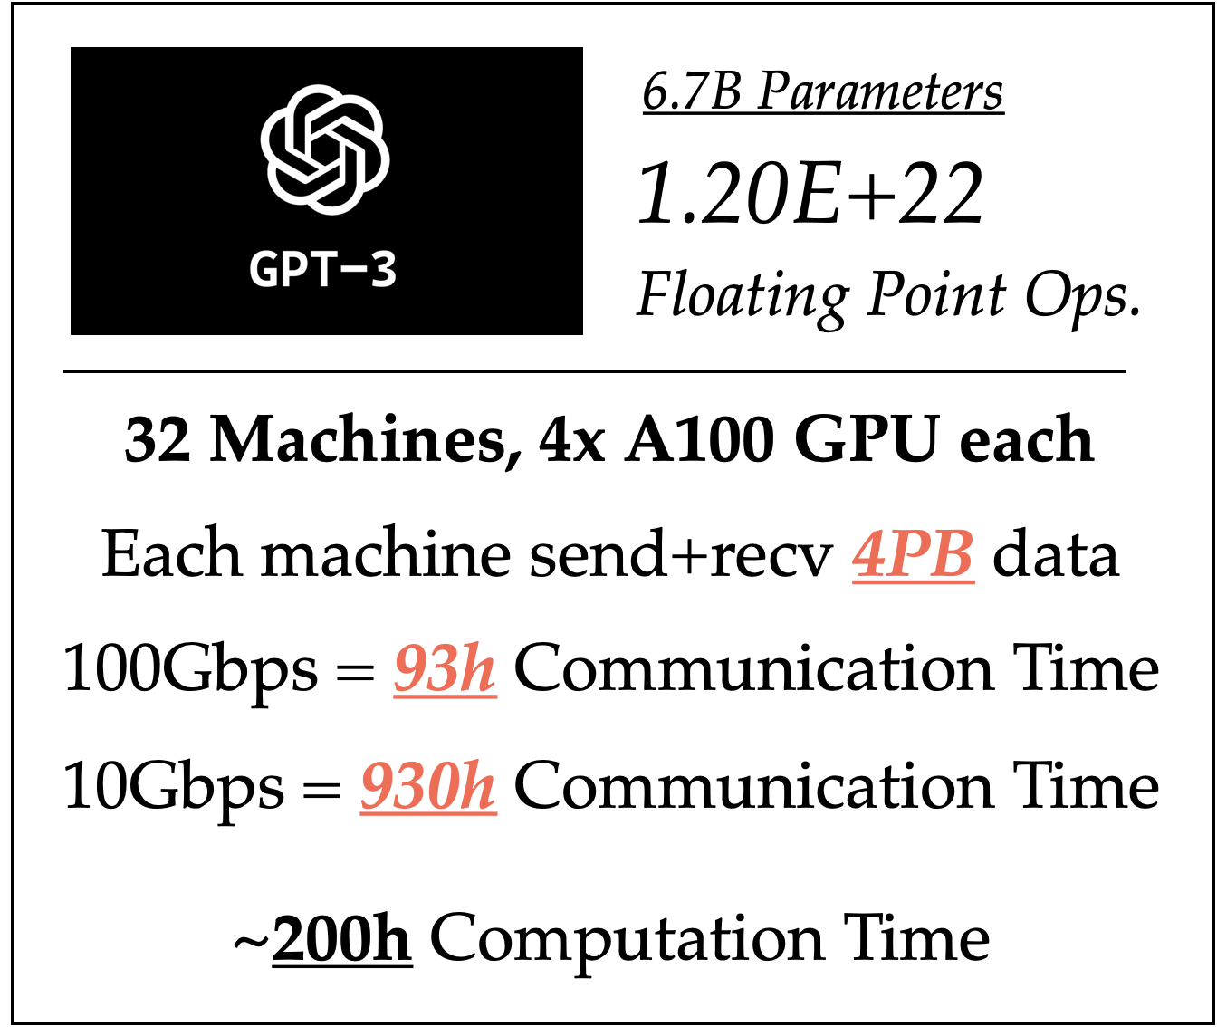
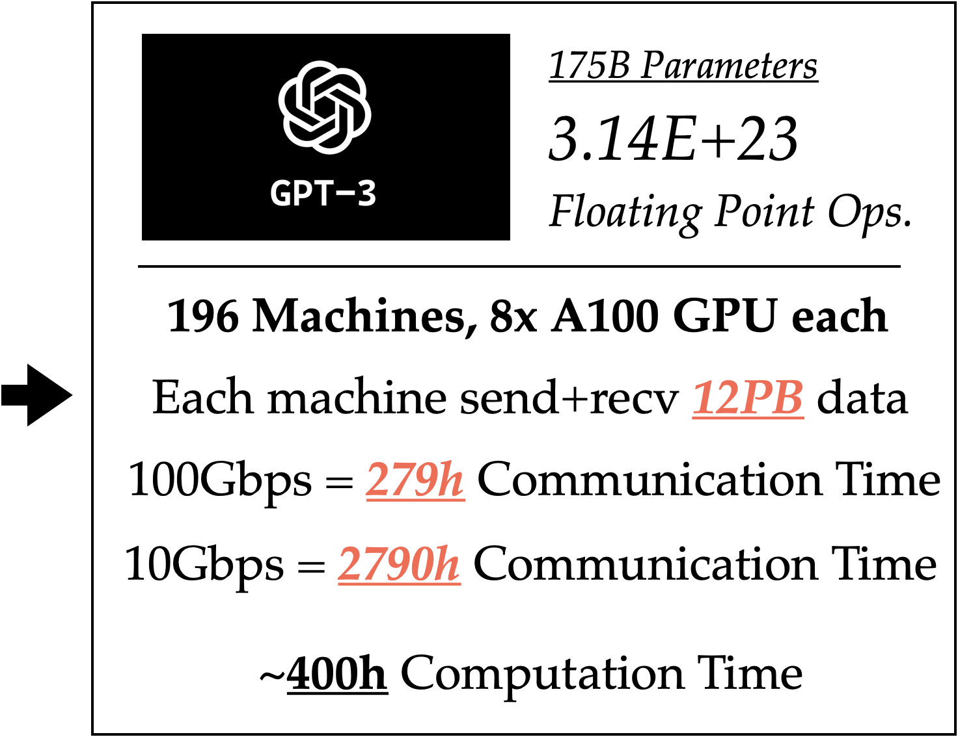
Decentralized Communication & Data Movement
Distributed training at scale is communication-intensive.
Future: 10x further scaling requires fast connections between 10x machines. Becoming challenging even for data center.
(Today) Model training today is largely restricted to centralized data centers with fast network connections. Hard to use cheaper alternatives (Tier 2-4 clouds, Spot Instances, Volunteer Computes, etc.).
Notes:
My insight to tackle the efficiency and quality problem is that we need to understand both the algorithms and the the hardware.
As an example, all ML is matmul and nonlinearility. And computational bottleneck is dense matmul. By looking at what’s fast and slow on GPUs and other accelerators, we can leverage block-sparsity that yields some of the first sparse methods with wall-clock speedup. I’ll talk about Monarch matrices, which is part of a long-line of work on learnable fast transforms.
For another application, attention, the heart of the transformer architecture, is fundamental to all these impressive capabilities. With FlashAttention, by using classical techniques such as tiling, we can reduce GPU memory reads/writes and bring significant speedup.
[Dan] Maybe this "thesis statement" can come early.
[Karan] Could be 1/2 as long, clearly, say more about who you are.
[Dan] Developing hardware-aware algo could help ML:
1. FlashAttention
2. Take sparsity ideas that's been around in the community and actually make that work.
[Neel] Lots of jargons.
Maybe too details for the intro
Don't say "i've been playing with"

Slide 11
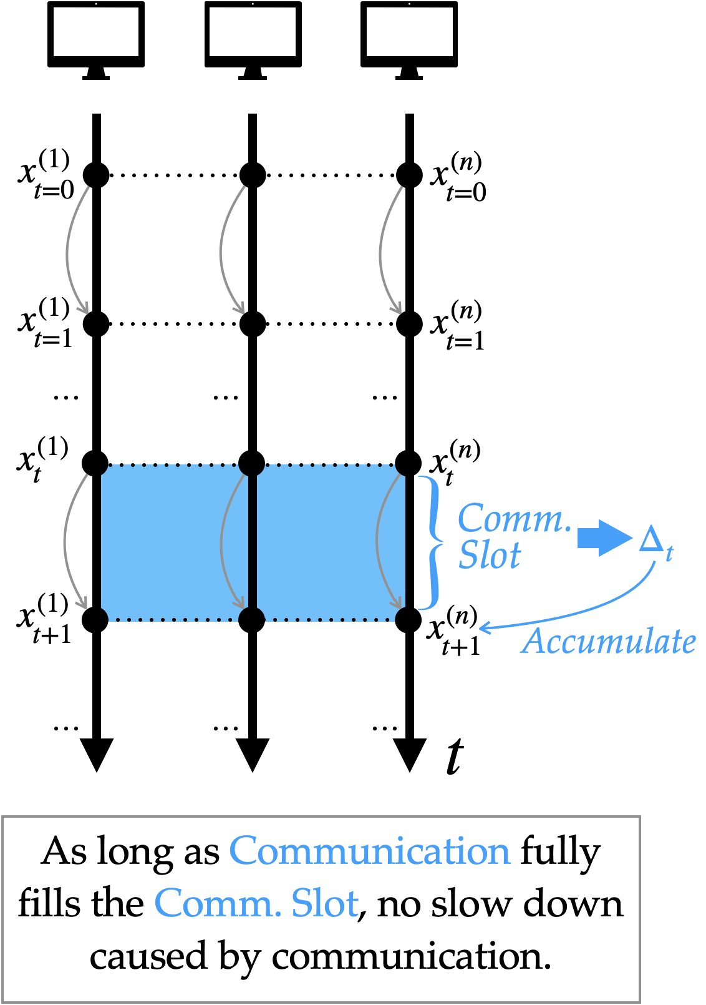
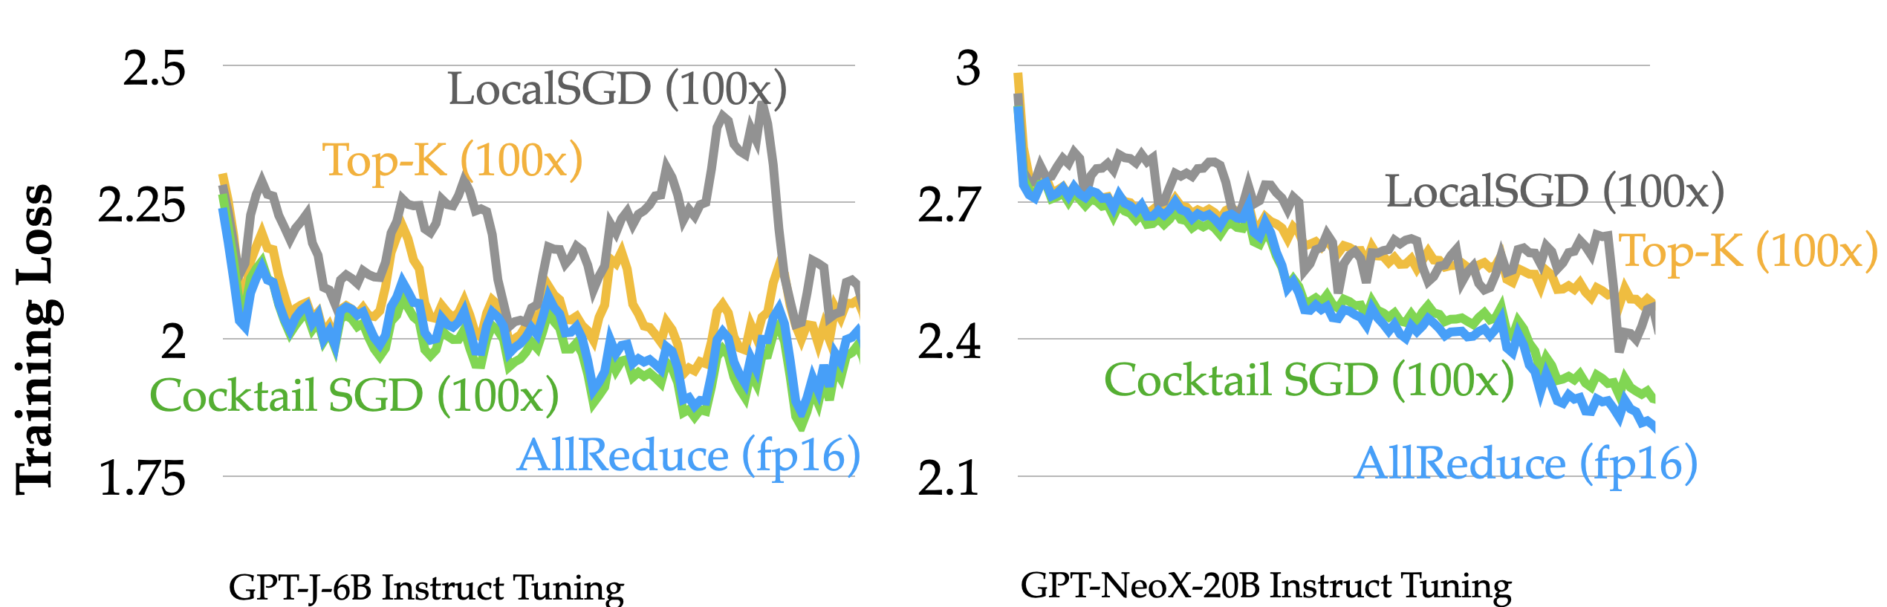
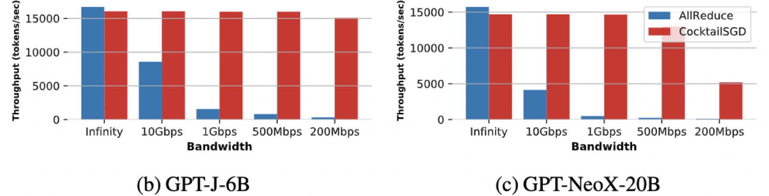
CocktailSGD: Mixture of Communication Compression Methods
Different communication compression techniques complement each other and compose well!
Data parallel over 1Gbps network!
Notes:
My insight to tackle the efficiency and quality problem is that we need to understand both the algorithms and the the hardware.
As an example, all ML is matmul and nonlinearility. And computational bottleneck is dense matmul. By looking at what’s fast and slow on GPUs and other accelerators, we can leverage block-sparsity that yields some of the first sparse methods with wall-clock speedup. I’ll talk about Monarch matrices, which is part of a long-line of work on learnable fast transforms.
For another application, attention, the heart of the transformer architecture, is fundamental to all these impressive capabilities. With FlashAttention, by using classical techniques such as tiling, we can reduce GPU memory reads/writes and bring significant speedup.
[Dan] Maybe this "thesis statement" can come early.
[Karan] Could be 1/2 as long, clearly, say more about who you are.
[Dan] Developing hardware-aware algo could help ML:
1. FlashAttention
2. Take sparsity ideas that's been around in the community and actually make that work.
[Neel] Lots of jargons.
Maybe too details for the intro
Don't say "i've been playing with"

Slide 12
Summary
Ongoing & Future Work: Optimizing Throughout the Stack
Different kinds of hardware
Efficient algorithms and kernels for training and inference
Diverse capabilities (long context) and new applications (multi-modal, genomics)

